Slide 1

Java for robotics Boot camp

Slide 2
“Von Neumann” architecture
Processing Unit
Program memory
Control unit
Data memory
Arithmetic-Logic Unit
Processor executes a sequence of instructions
Read
Arithmetic: addition, subtraction, rotation
Logic: and, or
Write
Branch, branch if true
Input/Output

Slide 3
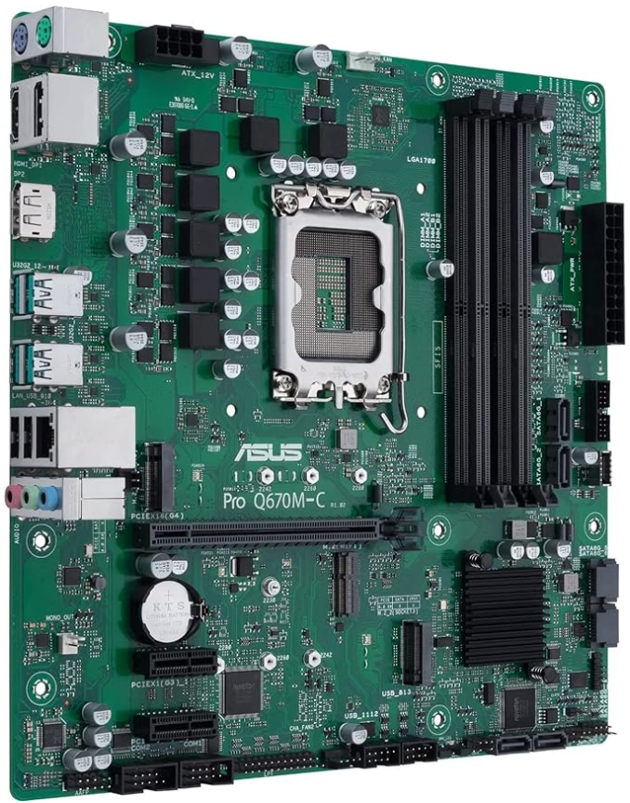
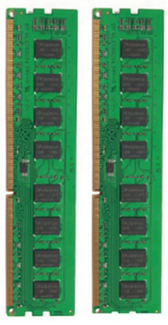

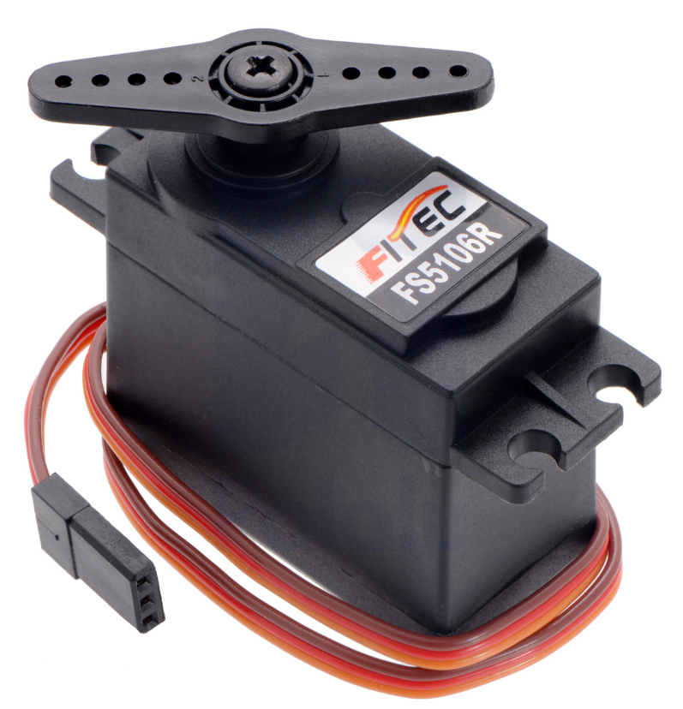
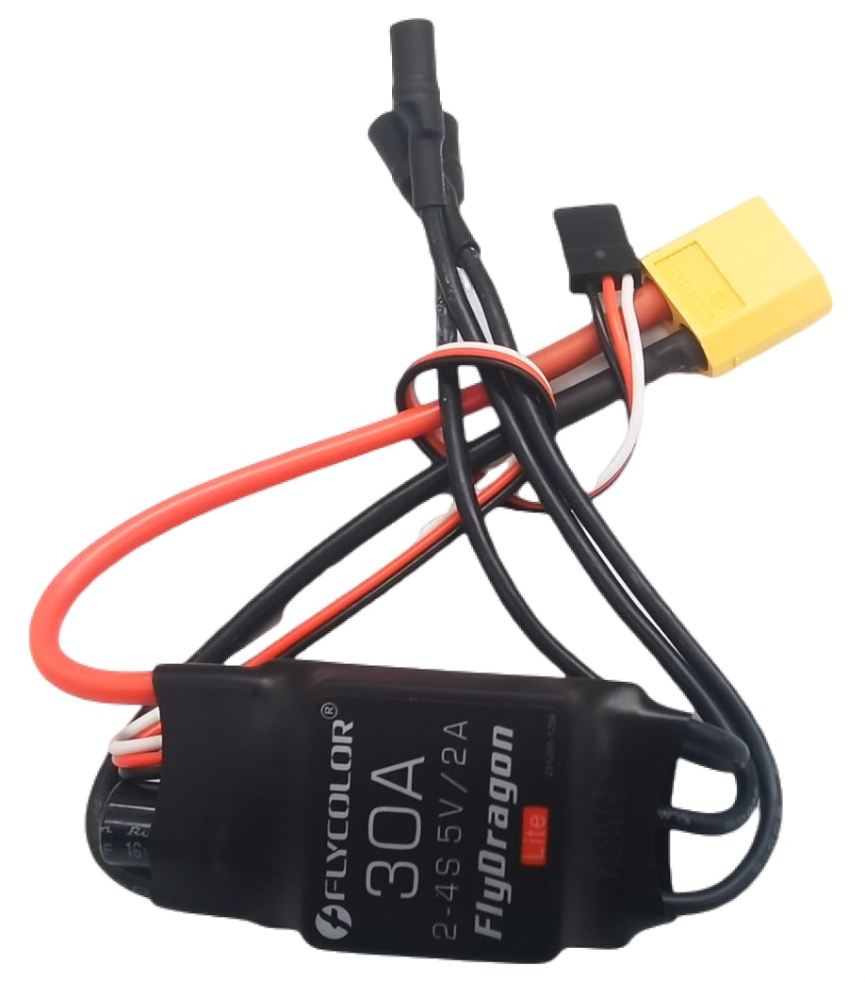
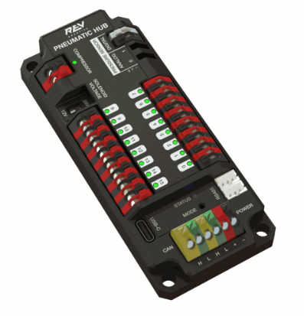

Modern Computer architecture
Processor
a.k.a. Central Processing Unit (CPU)
Commercially made by Intel, AMD, ARM, Apple, etc…
Executes instructions from memory
Read Only Memory (ROM)
a.k.a. boot memory, Basic Input/Output System (BIOS), boot flash
Random Access Memory (RAM)
a.k.a. memory, mem
In kilobytes (kB), megabytes (MB), gigabytes (GB)
Input/Output
General Purpose port (GPIO)
Pulse Width Modulation (PMW) or Analog ports
Serial ports (UART, I2C, SPI)
Controller Area Network (CAN bus)
Bus (USB, PCI, PCIe, …)
Keyboard
Ethernet
Camera
“Hard drive”*
or Solid State Drive (SSD)
Graphics card
a.k.a. Graphics Processing Unit (GPU)
Mouse
WiFi
USB stick
*Storage is usually flash memory, measured in GB

Slide 4
Running code
Power on or reset the system
Processor starts, runs the BIOS (bootloader)
Bootloader loads and runs the OS (Operating System), i.e. Windows, Linux, RoboRIO
OS initializes all connected systems, connects to the network
---------------------------------------------
You write the source code in Java using the WPILib environment in Visual Studio Code (or C++, Python, C#, …)
Compiler creates machine code (or intermediate code) from the source code and libraries
Loader deploys and runs the program/application

Slide 5
Java concepts
Programming language (for source code)
Runs on many platforms (PC, phone, server, …)
Object Oriented Programming
It is NOT JavaScript
Tutorial at https://www.w3schools.com/java/default.asp

Slide 6
Java syntax
Comments are included in the code; explain what you are doing
All code is contained in classes
The class name is PascalCase (first letter of each word capitalized)
The file name must match the class name (Example.java)
Curly braces {} delimit a block of code
Semicolon ; ends a code statement
The main() method is where your program starts
// This is a comment
public class Example {
public static void main(String[] args) {
System.out.println("Hello World");
}
}

Slide 7
Java variables
int - stores integers, without decimals, such as 123 or -123
float - stores numbers with decimals, such as 19.99 or -19.99
char - stores single characters, such as 'a' or 'B'
boolean - stores values with two states: true or false
String - stores text, such as "Hello“
Variable names (identifiers) are camelCase (first letter lower case, then first letter of each word capitalized)
To create a variable, declare its type and assign a value
type name = value;
You can use a variable by its identifier int other = myNum; or assign it another value myNum=10;
Arrays contain multiple elements of the same type
Access by index, starts at 0
Length is the size of the array
int myNum = 5; // Integer (whole number)
float myFloatNum = 5.99f; // Floating point number
char myLetter = 'D'; // Character
boolean myBool = true; // Boolean
String myText = "Hello"; // String
String[] cars = {"Volvo", "BMW", "Ford", "Mazda"};
int[] myNum = {10, 20, 30};
System.out.println(cars[0]);
// Outputs Volvo
System.out.println(cars.length);
// Outputs 4
System.out.println(myNum[2]);
// Outputs 30
System.out.println(cars[3]);
// Outputs???

Slide 8
Java flow control
if() {} else {} specifies a block of code to be executed if a condition is true (else is optional)
while() {} specifies a block of code to be executed as long as a condition is true
for(before;condition;iteration) {} specifies a block of code to be executed as long as a condition is true
Loops and ifs may be nested
break; jumps out of a loop
continue; jumps to the next iteration of a loop
int x = 20;
int y = 18;
if (x > y) {
System.out.println("x is greater than y");
} else {
System.out.println("y is greater than x");
}
int z = 0;
while (z < 5) {
System.out.println(z);
z++;
}
// Outer loop
for (int i = 1; i <= 2; i++) {
System.out.println("Outer: " + i); // Executes 2 times
// Inner loop
for (int j = 1; j <= 3; j++) {
System.out.println(" Inner: " + j); // Executes 6 times (2 * 3)
}
}

Slide 9
Object Oriented Programming (classes and objects)
How do we break down a complex problem in small, independent, easy to solve problems. Abstractions and contracts.
A class represent a concept or template
class Fruit {}
class Car {}
An object is a specific instance of a class
Fruit myFruit = new Fruit(“banana”);
Car myCar = new Car(“Tesla”);
Classes define attributes and methods
myFruit.m_name = “banana”;
myFruit.m_family = “Musaceae”;
myFruit.Eat();
myCar.StartEngine();
Objects are instantiated using constructors
class Age { float m_age; public Age(int years, int days) { m_age = years + (float)days / 365; } }
Age myAge = new Age(18,175);
A class may inherit from another class: reuse the attributes and methods of the parent class
class Plant { void Grow() {} }
class Tree extends Plant {}
class EvergreenTree extends Tree {}

Slide 10
Using Git
Repository/repo: your files, folder structure and change history; stored on the github server, i.e. at https://github.com/RamenRobotics9036/RamenBot2024
Clone: to make a copy of the server repo on your machine, i.e. a local repo
Commit: a particular saved state of the repo, i.e. a snapshot of all files; to commit is to create that snapshot, along with an explanation for the changes
Branch: a means of grouping a set of commits with their history. For example:
the main branch may contain all tested code
the release/june2023 branch may contain last year’s working code
the user/guillaume branch may contain all changes this contributor is currently working on
the feature/swerve branch may contain all changes currently related to the swerve feature
Push: update the server repo with your changes
Pull: update your local repo with changes from the server repo
Merge: combine various changes from different branches/commits
Pull request: a proposal to merge changes between two branches, usually to main It allows collaborators to review and discuss the changes before they are integrated

Slide 11
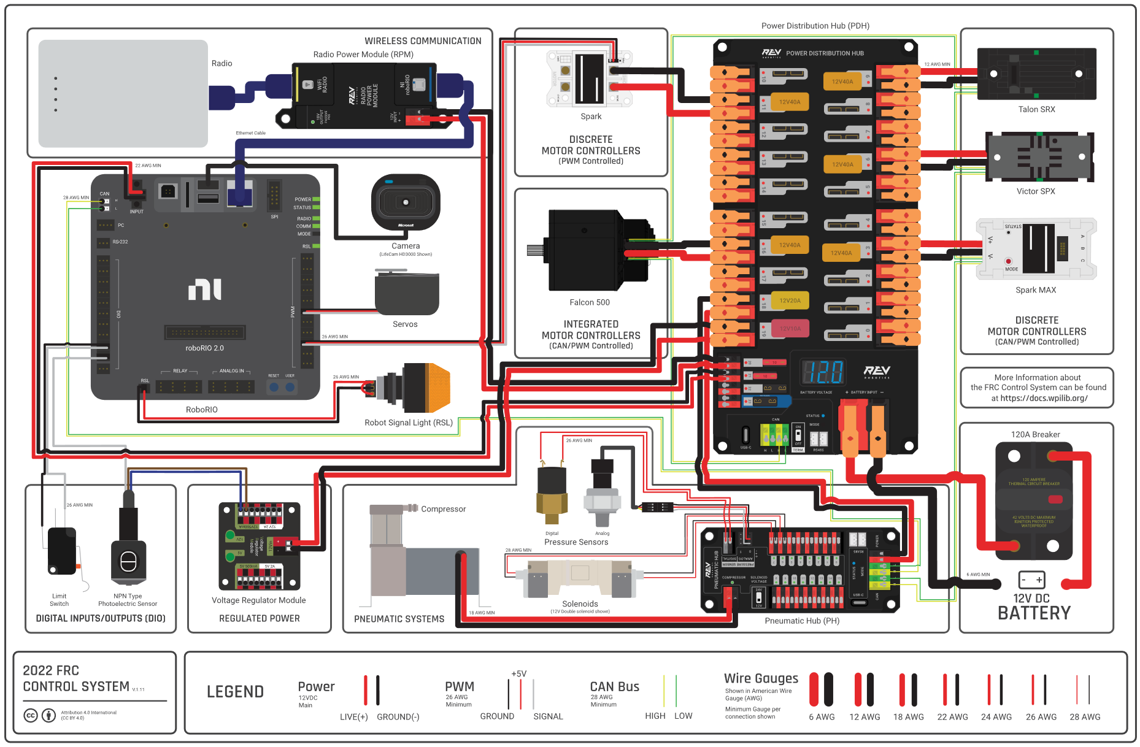
RoboRIO

Slide 12
WPILib https://wpilib.org/
[need content]

Slide 13
Git cheat sheet
https://github.com/RamenRobotics9036/RamenBot2024

Slide 14
Git and code changes
From Visual Studio
Switch to main branch
Pull (copy newest changes from github)
Create a new branch based on main, call it something related to your name or the task (no spaces), for example visiontest or
Code, deploy, test, repeat
Stage, review, and submit your changes (with a comment)
Push (copy your branch updates to github)
All unsubmitted changes will be lost!
Create a pull request when complete.

Slide 15
Resuming work in progress
From Visual Studio
Switch to yourbranchname branch
Pull (copy newest changes from github)
Code, deploy, test, repeat
Stage, review, and submit your changes (with a comment)
Push (copy your branch updates to github)
All unsubmitted changes will be lost!
Create a pull request when complete.

Slide 16
Create a pull request
Once code changes are completed and ready for everybody to use.
From https://github.com/RamenRobotics9036/RamenBot2024
Create a pull request base:main compare:yourbranchname
Reviewer looks at the code, may suggest changes
If changes needed, follow “resuming work in progress”
Once approved, github copies/merges the code to main

